Slide 1

W
E
L
C
O
M
E

Slide 2
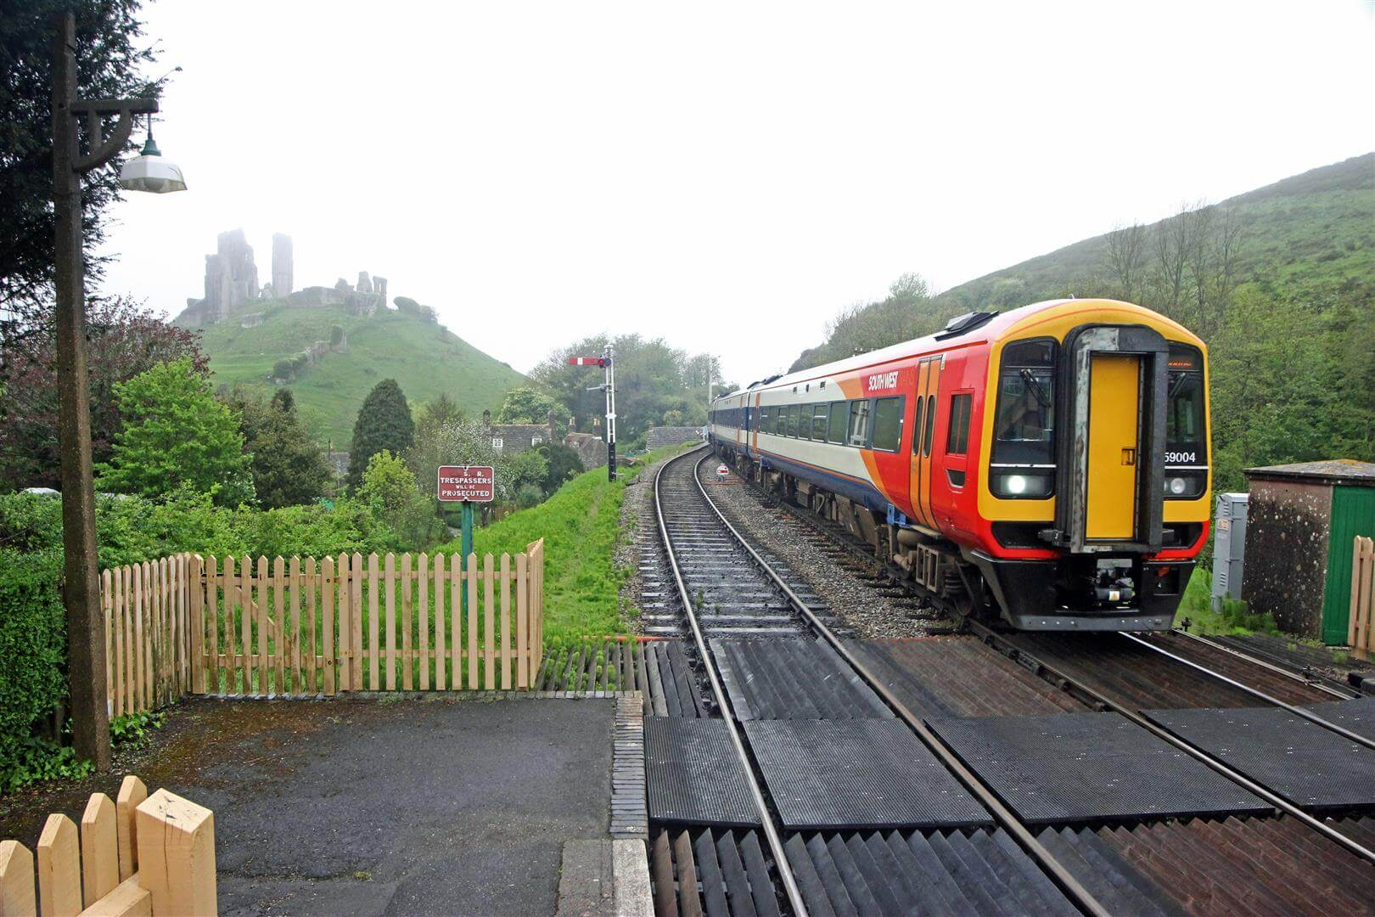
RAILWAY RESERVATION SYSTEM
Presented by:
Hawana Tamang(313420)
Kushal Pathak(313423)
Sama Nemkul Shrestha(313437)
Srijana Limbu(313446)

Slide 3
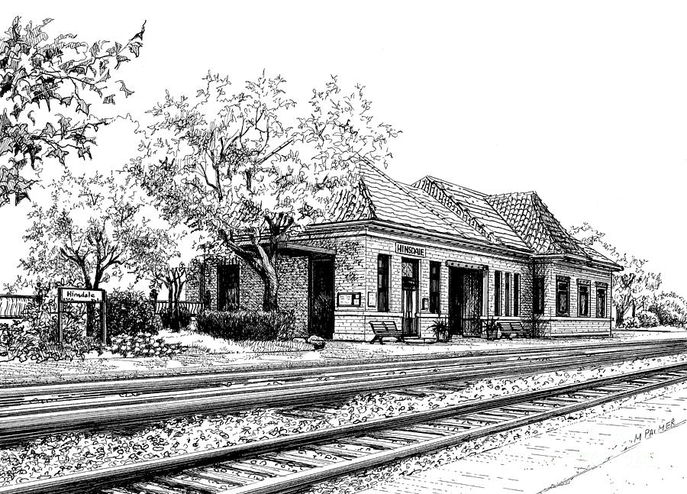






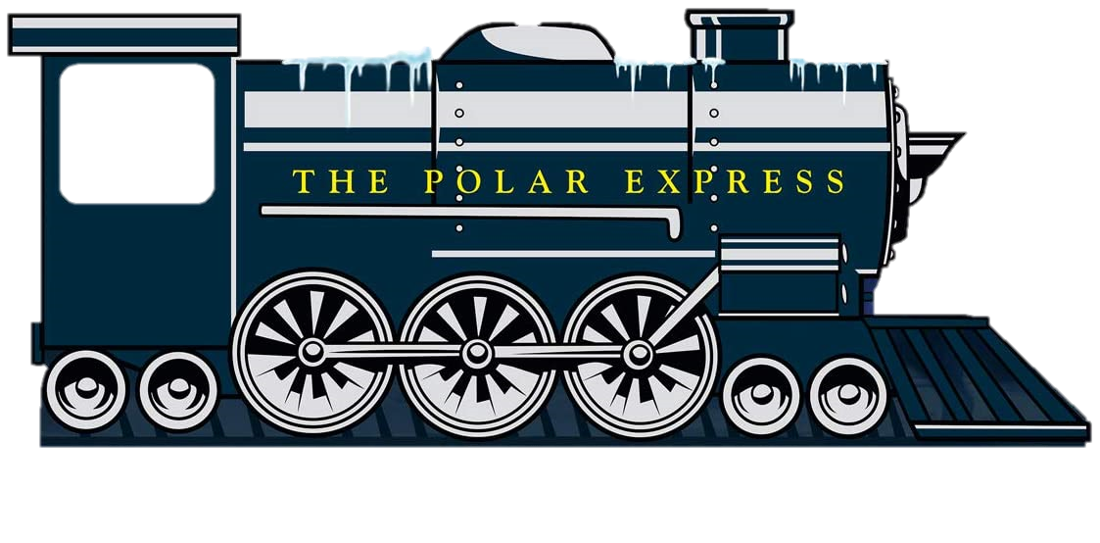


TABLE OF CONTENTS
Introduction
Introduction
Problem Statement
Problem Statement
Objectives
Objectives
Table of contents
Scope
Scope
System Flow
System Flow
Water fall model
Water fall model
Use case Diagram
Use case Diagram

Slide 4
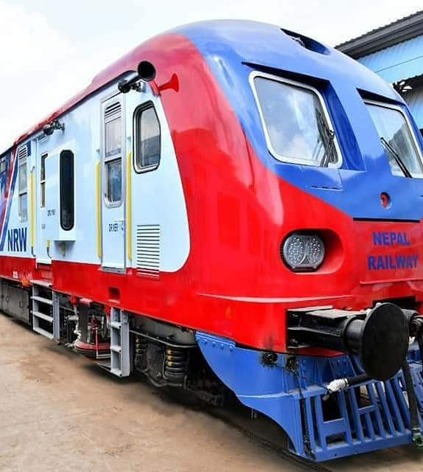
INTRODUCTION
The first railway service in Nepal was begun in 1927 AD with a length of 48 km between Amalekhagunj (Nepal) to Raxaul (India) which was closed in 1960 AD.
A second railway service was begun in 1937 AD connecting Jayanagar in India to Janakpur and Bijalpura in Nepal with the length of 51 km
Notes:
Source File;
https://unsplash.com/photos/EhTcC9sYXsw

Slide 5
Problem Statement
The major problem in manual ticket booking system is it is time consuming and less efficient.
Long queue while booking a ticket.
Railway station are unable to solve queries of the passenger.
Cancellation process in manual booking is difficult.
The number of ticket counters are less than the passengers travelling in train.

Slide 6
OBJECTIVES
To manage the details of Train ,Booking , Payment, Seat, Ticket.
To calculate the fare.
To cancel the ticket if necessary.
It manages all the information about Train Customer, Ticket etc.

Slide 7




SCOPE
Management of Passenger Data.
Greater efficiency
To save the environment by using paper free work
Minimize manual data entry.

Slide 8
SYSTEM FLOW
START
LOGIN
RESERVATION MENU
PRINT BILL/RECEIPT
VIEW SPECIFIC TRAIN DETAILS
VIEW AVAILABLE TRAINS
CANCEL
SEARCH
STOP

Slide 9
WATERFALL MODEL
Requirement Analysis
System Design
Implementation
Integration and Testing
Deployment and Maintenance

Slide 10
Railway Reservation System
USE-CASE DIAGRAM
Login
Reservation
Print Bill/Receipt
View specific train
View all available train
ADMIN
Cancel Reservation
Search details

Slide 11
Future Scope
We can give more advance software for “Railway Reservation System” including more facilities
Reservation details, train schedule, etc. can be updated and reports can be generated.
We can add the monthly pass system, freight revenue enhancement, etc.
Integrate multiple load balancers to distribute the loads of the system.
User interface can be made more effective.
Online booking can be integrated
.

Slide 12
Conclusion

